Slide 1

DEPARTEMENT OF COMPUTER SCIENCE & ENGINEERING
MANGALAM COLLEGE OF ENGINEERING ETTUMANOOR,
KOTTAYAM
(Affiliated to APJ Abdul Kalam Technological University)
LINGUAKIDS:EMPHASIZES LANGUAGE LEARNING TAILORED SPECIFICALLY FOR CHILDREN
Mentored by
Ms.Sachusha S Shaji
Assistant Professor,
Department of CSE
Submitted by,
Anagha Anil Kumar (MLM21CS029)
Ann Litta Joe (MLM21CS034)
Jinu Treesa Abraham (MLM21CS058)
Jithu Reji (MLM21CS060)

Slide 2
Contents
Objectives
Abstract
Introduction
Problem Definition
Literature Survey
Existing System Vs Proposed System
System Specification
System Architecture
Modules
Detailed Design
Result
Conclusion
Future Scope
References

Slide 3
Objectives
Develop a supportive environment to boost fluency and confidence.
Use interactive elements, such as avatar, to engage users.
Give immediate feedback on grammar mistakes.

Slide 4
Abstract
In today’s world, innovative educational tools are increasingly leveraging AI to enhance learning experiences for children. This AI-powered English language learning system is designed to make language learning enjoyable and effective for children. It catches spoken words, accurately transcribes them, corrects grammatical errors, and develops learning strategies unique to each child based on their development. It uses video avatars for interactive graphics, generative artificial intelligence (AI) for error correction and personalized learning routes, and automatic speech recognition (ASR) for accurate transcription. This method provides a rich and captivating learning environment that develops confidence and fluency in English.

Slide 5
Introduction
In today's world, knowing English has become crucial, especially at a young age.
However many children have significant difficulties when learning English, including difficulties pronouncing words correctly, hesitation when speaking, and a tendency for grammar and vocabulary mistakes.
These problems may undermine their confidence, obstruct their communication ability, and make them lose interest in the language.
For this reason, to maintain their interest and motivation, it is essential that learning English be engaging and fun.

Slide 6
Problem Definition
Children struggle with clear pronunciation, and existing tools often fail to capture their speech accurately.
The generate feedback that is too advanced for children to understand.
Current tools lack engaging and interactive features that effectively capture children's attention during learning.

Slide 7
Literature Survey
SI No. | NAME OF THE PAPER | AUTHORS | APPORACHES | DRAWBACKS
1. | Comuniqa : Exploring Large Language Models for Improving English Speaking Skills ACM(2023) | Manas Mhasakar, Shikhar Sharma, Apurv Mehra, Utkarsh Venaik, Ujjwal Singhal, Dhruv Kumar, Kashish Mittal | This paper examines how Large Language Models (LLMs) can improve English speaking skills in non-native contexts like India. Introducing Comuniqa, an LLM-based system, it greatly enhances access to language education | Limited personalization and adaptability Dependence on Human Comparison
2. | AI-based learning content generation and learning pathway augmentation to increase learner engagement Elsevier (2023) | Chaitali Diwan, Srinath Srinivasa, Gandharv Suri , Saksham Agarwal , Prasad Ram | Including narrative fragment generation using Natural language generation(NLG)model, automatic definitions, multiple-choice question creation, key-phrase extraction methods, and learning pathway augmentation | Generated content may lack relevance or accuracy. Effectiveness in classroom settings remains untested. Dataset Limitations.

Slide 8
Literature Survey
Sl No. | NAME OF THE PAPER | AUTHORS | APPORACHES | DRAWBACKS
3. | Artificial Intelligence education for young children: Why, what, and how in curriculum design and implementation Elsevier (2022) | Weipeng Yang | Emphasizing an embodied perspective tied to their experiences, culturally responsive projects that connect AI to prior knowledge, Experiential learning that builds on familiar concepts. | Maintaining accuracy and relevance could be challenging. Resource Limitations.
4. | Artificial Intelligence (AI) Literacy in Early Childhood Education: The Challenges and Opportunities Elsevier(2023) | Jiahong Su , Davy Tsz Kit Ng, Samuel Kai Wah Chu | Activity-based learning: which promotes self-directed activities,Experiential learning: emphasizing reflection on hands-on experiences, and Hands-on experience: encouraging direct interaction with AI tools. | Impacting effective implementation of the approaches. Challenges in AI literacy Curriculum issues

Slide 9
Literature Survey
Sl No. | NAME OF THE PAPER | AUTHORS | APPORACHES | DRAWBACKS
5. | Technology-Assisted Language Learning Adaptive Systems: A Comprehensive Review Elsevier(2023) | Parneet Kaur , Harish Kumar, Sakshi Kausha | Approaches in TALL includes adaptive learning for personalized experiences, intelligent tutoring systems for tailored instruction, computer-assisted language learning (CALL) using multimedia, natural language processing (NLP) for feedback and analysis. | Complexity of Implementation Limited Adaptation to Learning Styles Operational Challenges

Slide 10
EXISTING SYSTEM VS PROPOSED SYSTEM
Existing System | Proposed System
Generally focuses on adult users . | Specifically designed for children.
Primarily trained on adult speech, leading to lower accuracy with children's voices. | Uses Finetuned ASR model which is trained specifically on children's dataset.
Typically provide the same feedback to all users based on general error patterns | Continuously assesses the child’s progress and adapts based on it.
Most existing systems focus on audio-based feedback . | Makes use of AI avatar for producing feedback.

Slide 11
SYSTEM REQUIREMENTS
Software Requirements:
Hardware Requirements:
Operating System: Windows 10/11.
Python Version: Python 3.8 or higher.
Machine Learning Libraries:
Hugging FaceTransformers
Deployment Framework: Streamlit3.
Development Tools: IDE: VSCode,
Google colab
Laptop

Slide 12
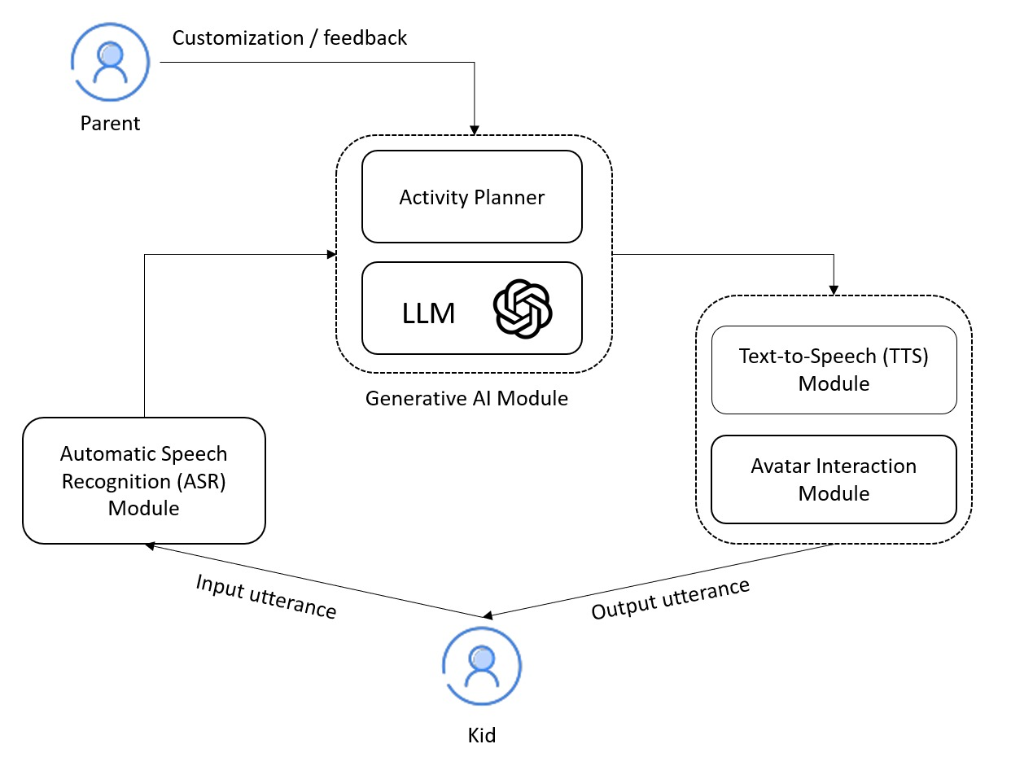
System Architecture

Slide 13
METHODOLOGY
MODULES
Automatic Speech Recognition
Generative AI Module
Text To Speech conversion

Slide 14
Modules
ASR Module (Automatic Speech Recognition)
The child speaks into the microphone.
The ASR module captures and converts the spoken sentence into text using Finetuned Whisper.
This forms the input for the next module.

Slide 15
Modules
2. Gemini - LLM Module
The LLM (Gemini) receives the transcribed sentence.
It analyzes grammar and sentence structure.
The output is a corrected sentence, often simplified for child understanding.
3. Text-to-Speech
The corrected sentence is fed into the Text-to-Speech (TTS) module.
Integrate the speech output with an animated avatar to speak interactively to the child.

Slide 16

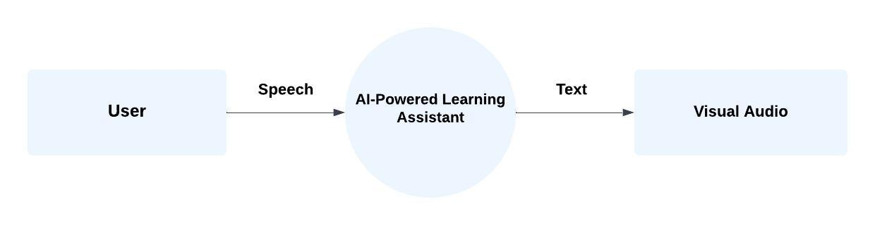

Slide 17
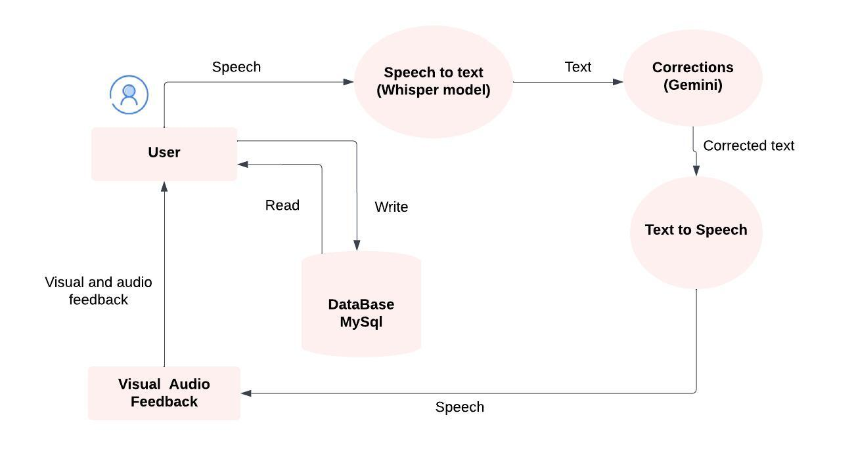
DFD –LEVEL 1

Slide 18
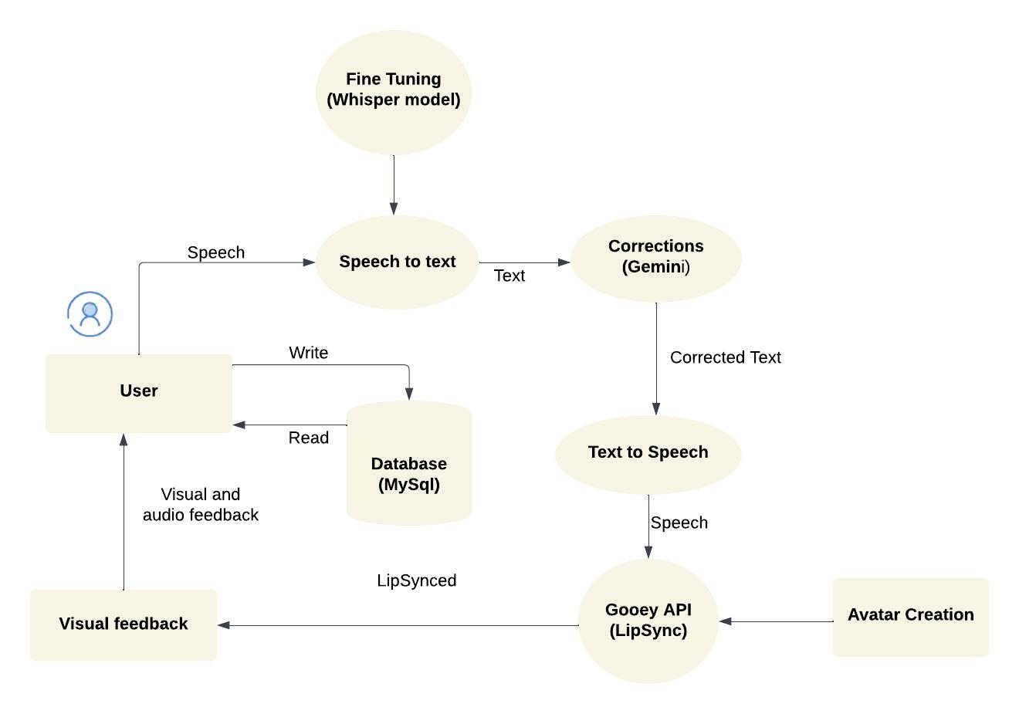
DFD – LEVEL 2

Slide 19
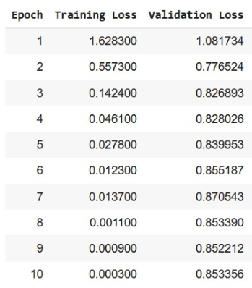
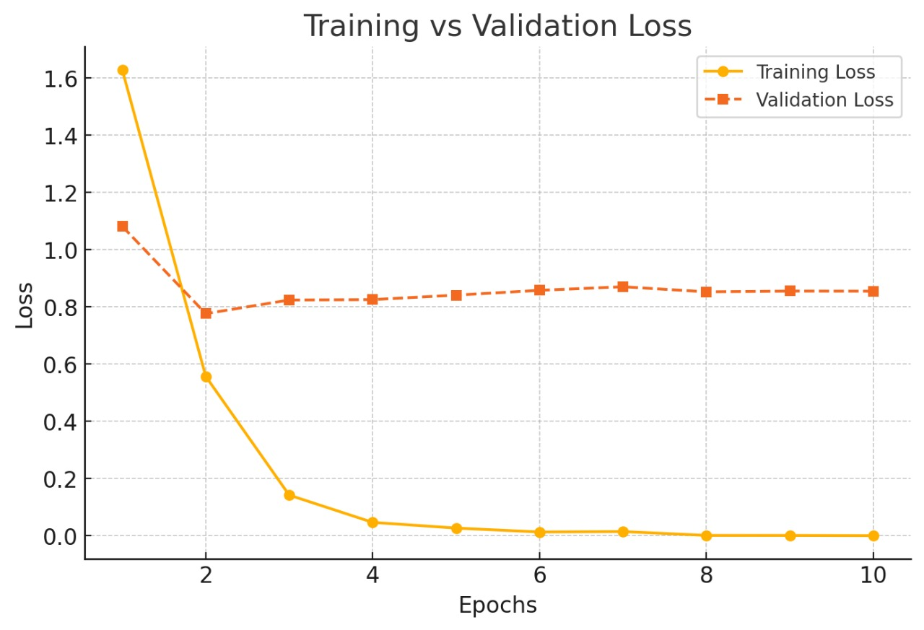
Result

Slide 20
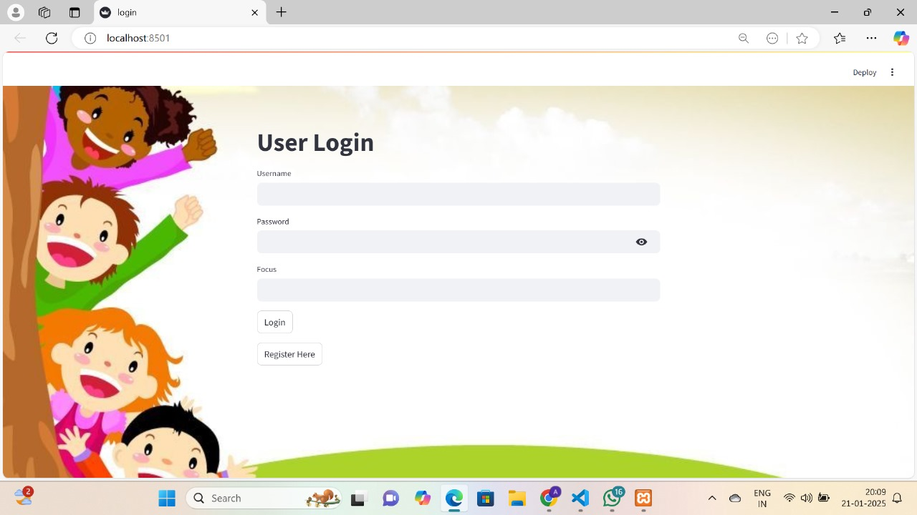
Result

Slide 21
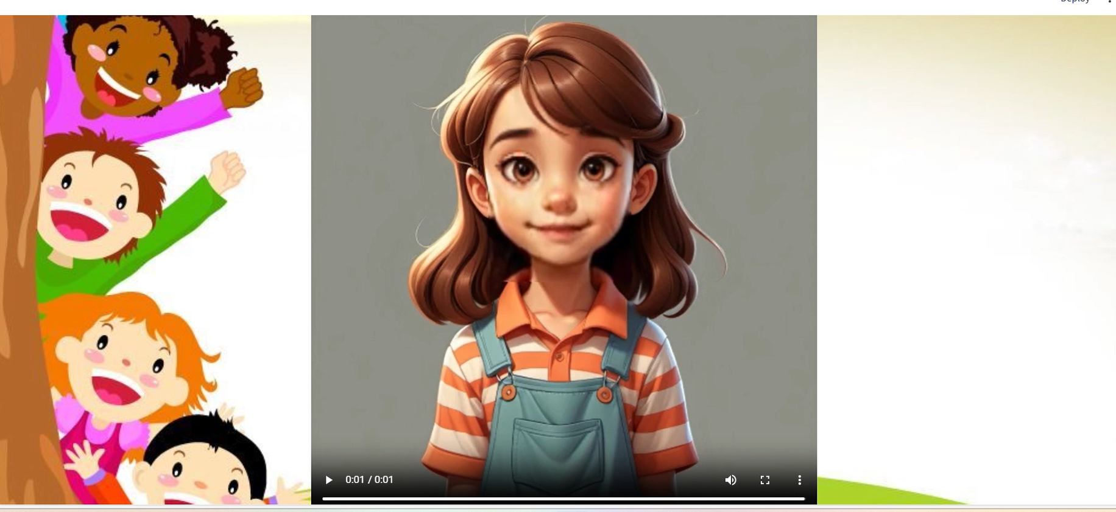
Result

Slide 22


Result

Slide 23
Conclusion
In conclusion our project ,the AI-driven English learning system for kids offers a new way to teach the English language. This program makes learning English fun and interactive while customizing the experience for each child. It includes features that provide quick feedback and interactive avatars. The goal of this project is to inspire a passion for learning the language, boost confidence, and give children the skill to speak the English language .

Slide 24
Future Scope
It can expand to support multiple languages, offering personalized learning paths for various languages.
Integrating Augmented Reality (AR) would create immersive learning experiences, allowing children to practice English in real-world scenarios.

Slide 25
REFERENCES
[1] Manas Mhasakar, Shikhar Sharma, Apurv Mehra, Utkarsh Venaik, Ujjwal Singhal, Dhruv Kumar, and Kashish Mittal. 2024. Comuniqa : Exploring Large Language Models for Improving English Speaking Skills. In ACM SIG-CAS/SIGCHI Conference on Computing and Sustainable Societies (COMPASS’24), July 08–11, 2024, New Delhi, India. ACM, New York, NY, USA, 12 pages.https://doi.org/10.1145/3674829.3675082
[2] Chaitali Diwan , Srinath Srinivasa a, Gandharv Suri a, Saksham Agarwal a, Prasad Ram. AI-based learning content generation and learning pathway augmentation to increase learner engagement. 2666-920X/© 2022 Elsevier doi.org/10.1016/j.caeai.2022.100110.
[3] Weipeng Yang, Artificial Intelligence education for young children: Why, what, and how in curriculum design and implementation 2666-920X/© 2022 The Author. Published by Elsevier Ltd doi.org/10.1016/j.caeai.2022.100061.
[4] Jiahong Su , Davy Tsz Kit Ng, Samuel Kai Wah Chu, Artificial Intelligence (AI) Literacy in Early Childhood Education: The Challenges and Opportunities. 2666-920X/© 2023 The Authors. Published by Elsevier Ltd doi.org/10.1016/j.caeai.2023.100124.
[5] Parneet Kaur , Harish Kumar, Sakshi Kausha , Technology-Assisted Language Learning Adaptive Systems: A Comprehensive Review. 2666-3074/© 2023 The Authors. Published by Elsevier Ltd doi.org/10.1016/j.ijcce.2023.09.002.

